Slide 1





















Fraud Credit Card Transactions Detection
Prepared By:
Waddah Alhajar – 2049298
Alhajar.2049298@studenti.uniroma1.it
B USINESS MEET
Business Presentation Template

Slide 2
In this digital age, where financial transactions are increasingly conducted online, the risk of credit card fraud has become a major concern for individuals and financial institutions alike. The ability to detect and prevent fraudulent activities is crucial for maintaining the security and trust in the financial systems.
According to a report by Nilson[1], the global card fraud losses exceeded $27 billion in 2018, and the trend is rising. To mitigate the impact of fraud, it's crucial to develop effective fraud detection models. In this project, I aim to build a binary classification model to detect fraudulent credit card transactions using machine learning algorithms.
Overview
Source[1]: Nilson Report – Card Fraud Losses Reach $28.65 Billion

Slide 3
The dataset used for this project is the Credit Card Fraud Detection dataset from Kaggle[2].
The dataset contains transactions made by credit cards
in September 2013 by European cardholders.
It has 284,807 transactions, out of which 492 are fraudulent.
The dataset contains 30 features, most of which are anonymized due to privacy concerns.
Dataset
[2] https://www.kaggle.com/mlg-ulb/creditcardfraud

Slide 4
Approach
Using Different Metrics to evaluate the performance of algorithms
Logistic Regression
Decision Tree
Random Forest
Support Vector Machin (SVM)
Neural Network
XGBoost Classifier
Testing
and Results
Applying Algorithms
Using SMOT
Data Imbalance fixing
Data exploring and cleaning
-Deleting duplicates
-Dropping null values
-Scaling the Amount column

Slide 5
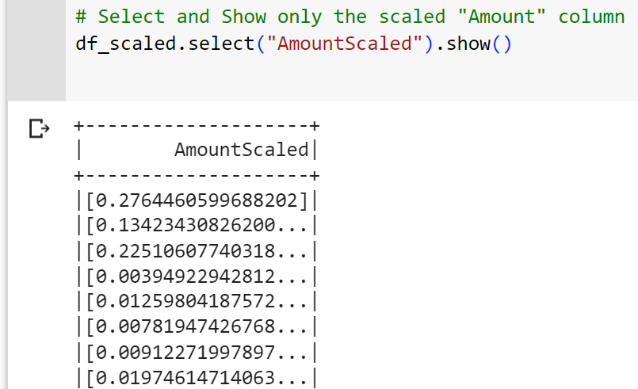
I used Standard Scaler which transforms the data to have a zero mean and unit standard deviation. I have chosen it because it gets affected by outliers unlike min max scaling, and I think that when we talk about fraud and unusual transactions then there is a good chance that outliers would belong to this category.
Amount Scaling

Slide 6
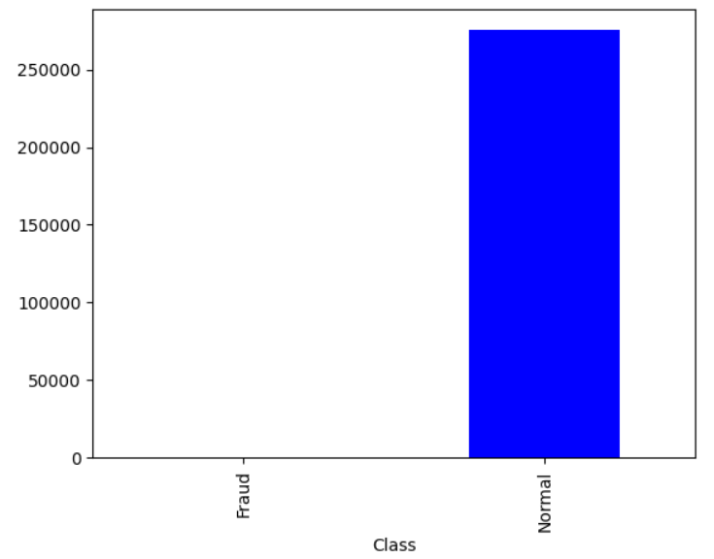
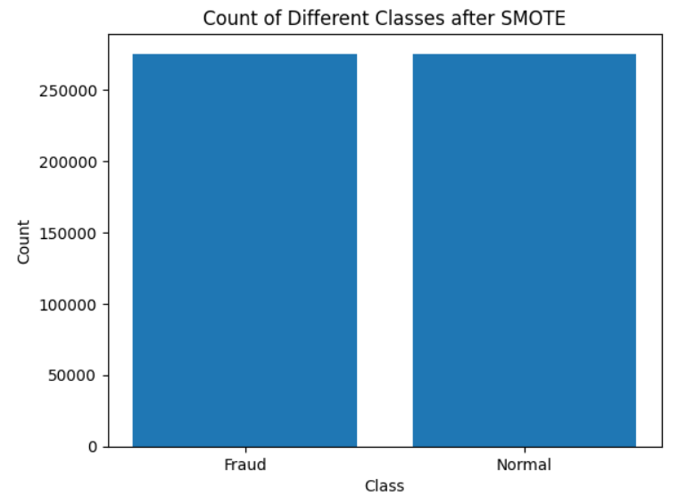
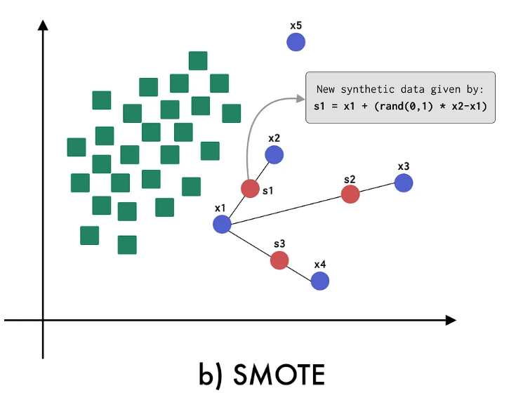
Data Imbalance Fixing
The dataset contains 492 out of 284,807 transactions which means that we have data imbalance that needs to be fixed
The classifiers may struggle to accurately learn patterns and make predictions, as it tends to favour the majority class
Synthetic Minority Over-sampling Technique
Select a minority class instance: Randomly choose an instance from the minority class.
Find its k nearest neighbors: Compute the distances between the selected instance and its k nearest neighbors from the same class.
Generate synthetic samples: Randomly select one of the k nearest neighbors and create a synthetic sample by interpolating between the selected instance and the chosen neighbor.
Repeat the steps until the desired balance is achieved

Slide 7
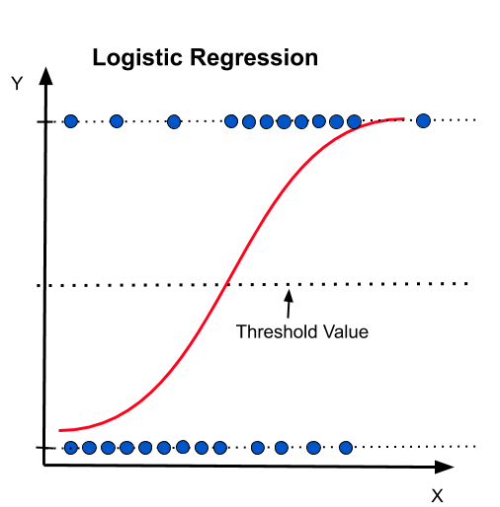
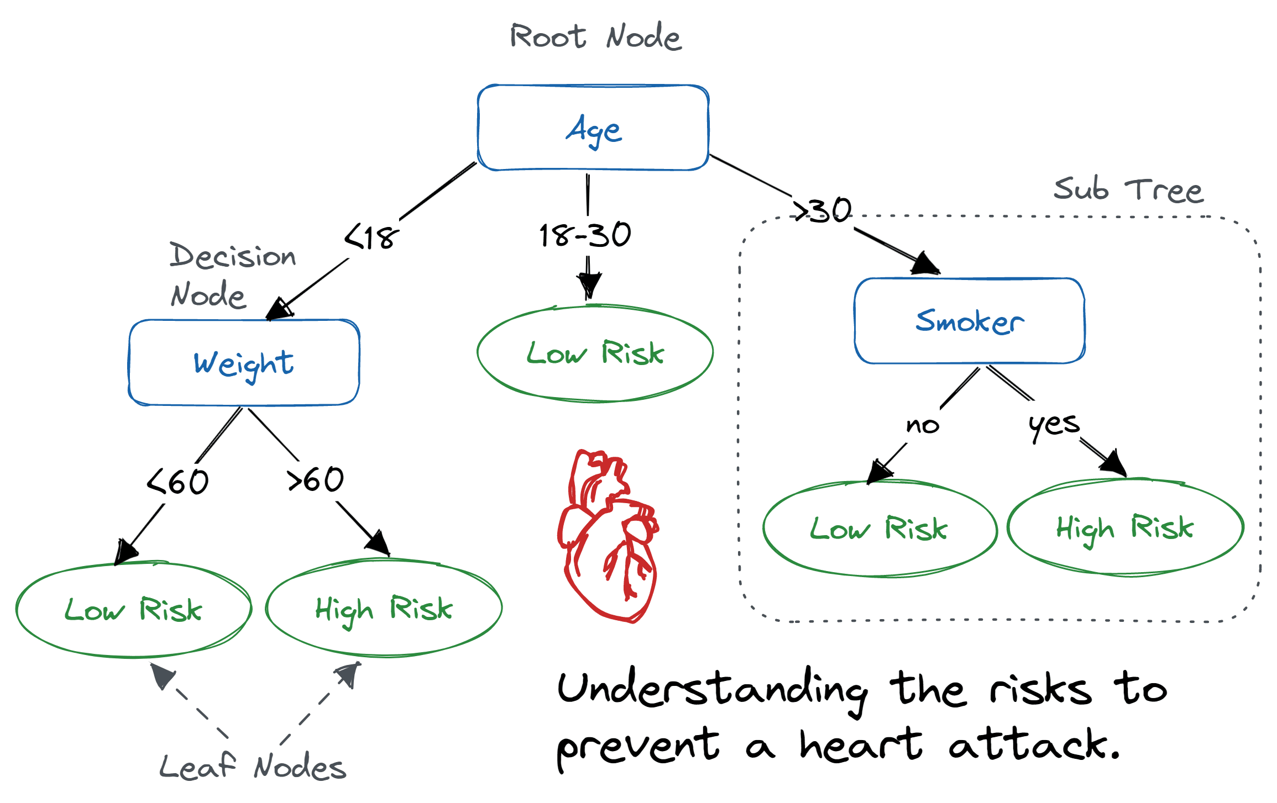
Algorithms used:
1- Logistic Regression
Logistic Regression is a popular algorithm used for binary classification tasks. It models the relationship between the dependent and the independent variables using the logistic function. Logistic Regression estimates the probabilities of the binary outcome based on the input features and applies a threshold to make predictions. It is computationally efficient, interpretable, and works well with linearly separable data.
Image credit: ai.plainenglish.io
2- Decision Tree:
Decision Tree algorithm builds a tree-like model of decisions and their possible consequences. It recursively splits the data based on feature thresholds to create a hierarchical structure of if-else conditions.
Image credits: Datacamp

Slide 8
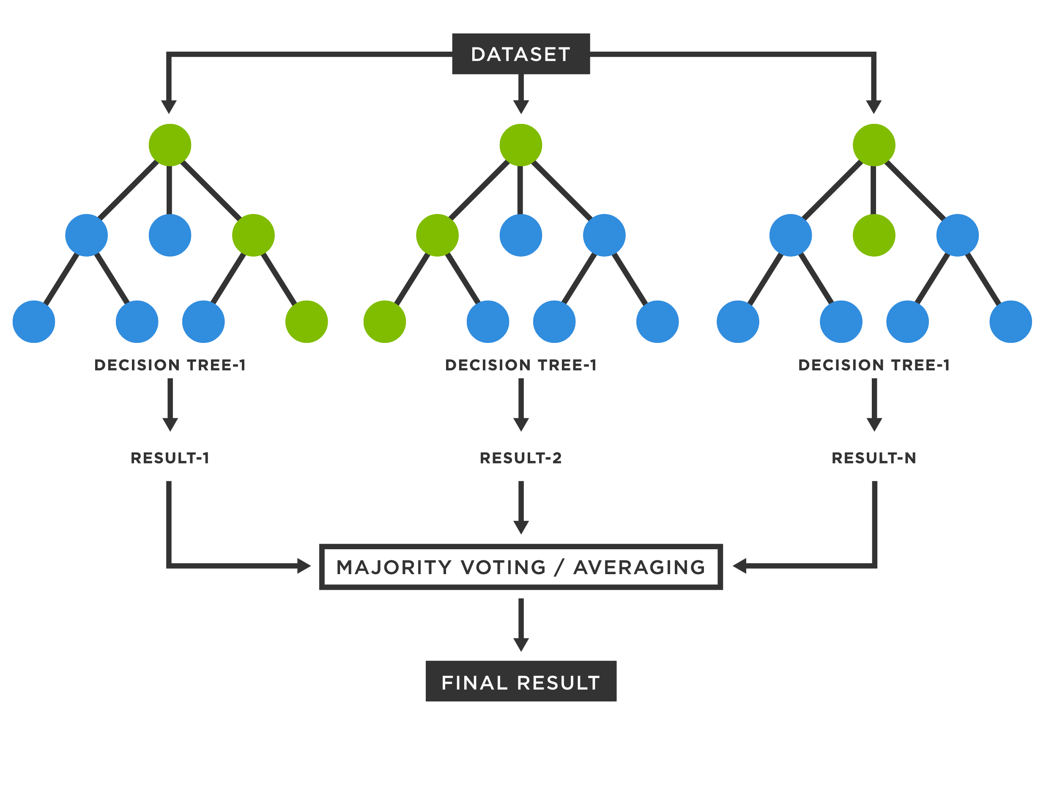
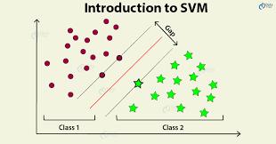
Algorithms used:
3- Random Forest
Random Forest is an ensemble learning algorithm that combines multiple Decision Trees. It works by creating a set of decision trees on random subsets of the training data and features. During prediction, each tree in the forest independently predicts the class, and the final prediction is determined by majority voting. Random Forest reduces overfitting.
Image credit: TIBCO Software
4- Support Vector Machine :
SVM finds an optimal hyperplane that separates the data points of different classes with the largest margin.
Image credits: DataFlair

Slide 9
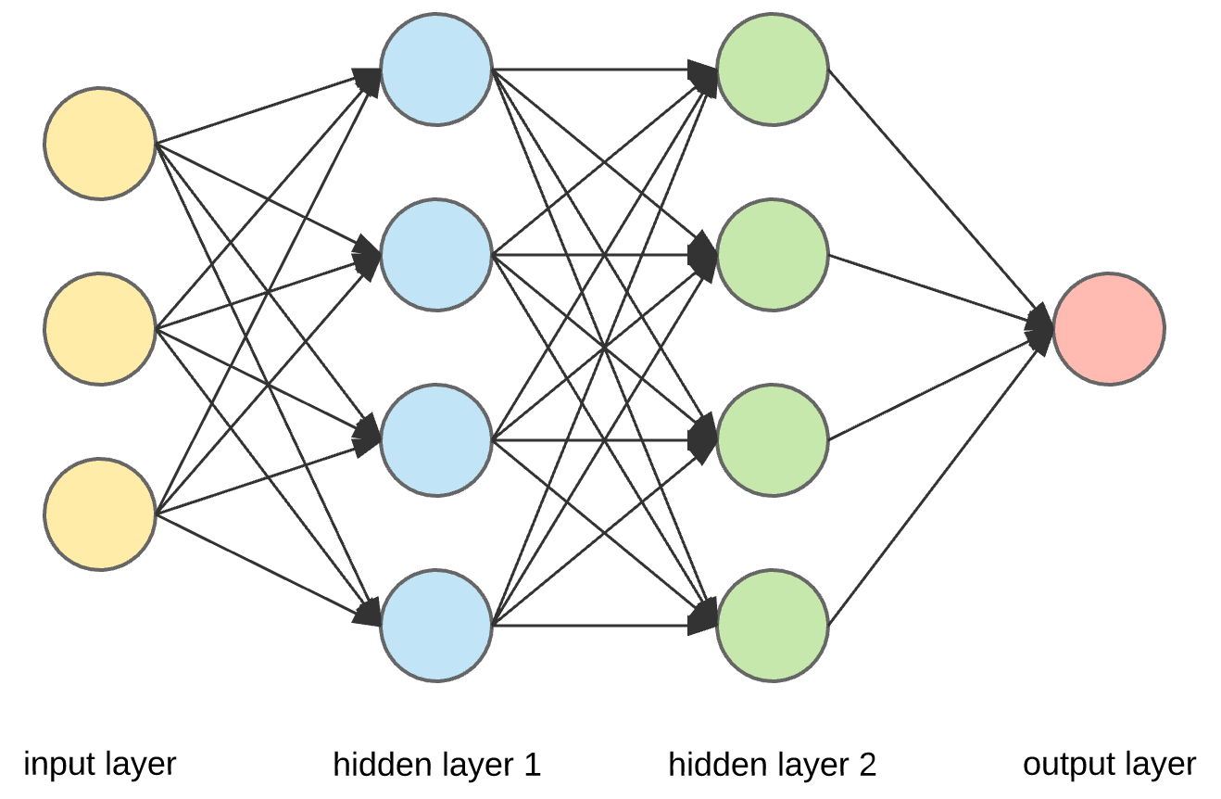
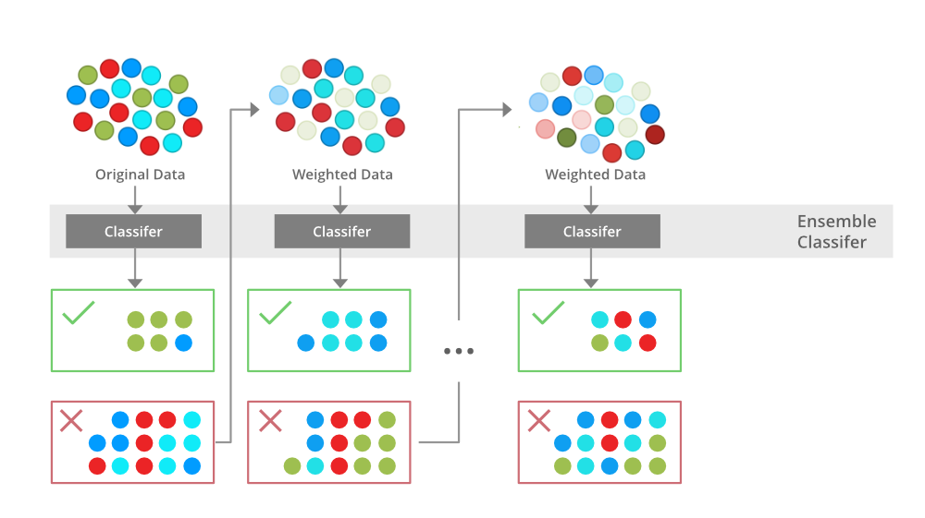
Algorithms used:
5- Neural Network:
Neural Networks are a class of deep learning models inspired by the structure and function of biological neural networks. They consist of interconnected layers of artificial neurons that process and transmit information. Neural Networks can learn complex relationships in data by adjusting the weights and biases of the connections between neurons. They excel at capturing non-linear relationships.
Image Credit: Towards Data Science
6- XGBoost:
Extreme Gradient Boosting is an optimized implementation of the gradient boosting algorithm. It is a powerful ensemble learning algorithm that combines weak predictive models (typically decision trees) to create a strong predictive model. XGBoost applies a boosting technique where new models are trained to correct the errors made by the previous models. It uses a gradient descent optimization algorithm to minimize a loss function and improve model performance. XGBoost is known for its speed, scalability, and ability to handle large datasets. Image credits: medium.com

Slide 10
Evaluation Metrics used:
1- Precision:
Precision is a metric that measures the accuracy of positive predictions made by a classifier. It is calculated as the ratio of true positives (TP) to the sum of true positives and false positives (FP). Precision focuses on the relevant instances among the predicted positive instances and indicates how precise the model's positive predictions are. The formula for precision is:
Precision = TP / (TP + FP)
2- Recall:
Recall, also known as sensitivity or true positive rate (TPR), measures the ability of a classifier to identify all positive instances correctly. It is calculated as the ratio of true positives (TP) to the sum of true positives and false negatives (FN). Recall focuses on the relevant instances among the actual positive instances and indicates how well the model captures positive instances. The formula for recall is:
Recall = TP / (TP + FN)

Slide 11
Evaluation Metrics used:
3- F1 Score:
The F1 score is a measure that combines precision and recall into a single metric, providing a balanced evaluation of a classifier's performance, and it ranges between 0 and 1. The F1 score reaches its best value at 1 (perfect precision and recall) and worst value at 0 (either precision or recall is 0). The formula for the F1 score is:
F1 Score = 2 * (Precision * Recall) / (Precision + Recall)
4- Area under PR:
The area under the precision-recall curve (AUPRC) is a metric used to evaluate the performance of a binary classifier. It plots precision against recall. A higher AUPRC value indicates better model performance in terms of precision and recall. The AUPRC ranges from 0 to 1, with 1 being the best performance. The AUPRC is calculated by computing the integral under the precision-recall curve.

Slide 12
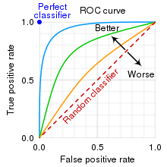
Evaluation Metrics used:
5- AUROC:
The area under the receiver operating characteristic curve (AUC-ROC) is a popular metric for evaluating the performance of binary classifiers. The ROC curve plots the true positive rate (TPR) against the false positive rate (FPR) at various classification thresholds. The AUC-ROC represents the probability that a randomly chosen positive instance will be ranked higher than a randomly chosen negative instance by the classifier. The AUC-ROC ranges from 0.5 to 1, where 0.5 represents a random classifier and 1 represents a perfect classifier. The AUC-ROC is calculated by computing the integral under the ROC curve.
TPR = TP / (TP + FN)
FPR = FP / (FP + TN)
Image Credit: Wikipedia

Slide 13
Testing Results
AUC-ROC: 0.998142266552781
Precision: 0.9806622493322064
Recall: 0.9806113537117904
F1 score: 0.9806104644664303
AUPRC :0.979581
Logistic Regression
OPTION 01
OPTION 01
Area Under ROC Curve : 0.993924
Precision : 0.980662
Recall: 0.980662
F1 Score : 0.993928
AUPRC:0.990677
Decision Tree
Random Forest
AUC-ROC: 0.9899008143885121
Precision = 0.99
Recall = 0.99
F1 Score: 0.9899264384835587
Area under PR : 0.9927207827042286
OPTION 01
OPTION 01
AUC-ROC: 0.974950651658105
Precision = 0.96
Recall = 0.95
F1 Score: 0.9534964683755565
Area under PR: 0.9535953420669577
SVM
AUC-ROC: 0.9943596553620162
Precision = 0.9943605524363237
Recall = 0.9943522561863174
F1 Score: 0.9943522749495959
Area under PR: 0.9943522561863174
XGBoost

Slide 14
Testing Results
Hyperparameters :layers = [29, 20, 10, 2], max_iter = 100, tolerance = 1e-6, block_size = 128, solver = "l-bfgs“, step_size = 0.03]
AUC-ROC: 0.9955877186430643
Precision: 0.9955992696527829
Recall: 0.9955749636098981
F1 score: 0.9955749663100978
AreaUnderPR: 0.9975048461855066
Neural Network
NN2
OPTION 01
Hyperparameters :layers = [29, 18, 8, 2], max_iter = 150,tolerance = 1e-6,block_size = 128,solver = "l-bfgs“, step_size = 0.02
AUC-ROC: 0.9972145999241376
Area under PR : 0.9945931350646661
F1 Score: 0.9972052480952676
Recall = 0.9972052401746725
Precision = 0.9972183456446311
OPTION 01
Hyperparameters : layers = [29, 25, 20, 15, 10, 5, 2], max_iter = 200,tolerance = 1e-8,block_size = 64,solver = "gd“,step_size = 0.01
AUC-ROC: 0.6071375424365785
Area under PR: 0.5892540611221115
F1 Score: 0.6066905060681527
Recall = 0.6072780203784571
Precision = 0.6077575936151474
NN3
NN5

Slide 15
Testing Results
Hyperparameters: layers = [29, 20, 10, 5, 2],max_iter = 100,tolerance = 1e-6,block_size =128,
solver = "gd“,step_size = 0.01
AUC-ROC: 0.5
Precision: 0.24816930264487713
Recall: 0.49816593886462884
F1 score: 0.3312974834188927
AreaUnderPR: 0.49816593886462884
NN4
OPTION 01
NN5
OPTION 01
Hyperparameters :layers = [29, 25, 20, 15, 10, 5, 2],max_iter = 200,tolerance = 1e-8,block_size = 64,solver = "l-bfgs“,
step_size = 0.01
AUC-ROC: 0.9984336930038287
Area under PR : 0.9968542467668647
F1 Score: 0.9984279527783958
Recall = 0.9984279475982534
Precision = 0.9984328928871787
This is the best performance !
NN5

Slide 16
L-BFGS
L-BFGS (Limited-memory Broyden-Fletcher-Goldfarb-Shanno) algorithm is a widely used optimization algorithm for training neural networks. L-BFGS is an iterative optimization algorithm that approximates the Hessian matrix, which represents the second-order derivatives of the loss function with respect to the weights of the neural network.
It is the optimizer that produced the best performance in our case.

Slide 17
Results Summarization
Model | Precision | Recall | F1 Score | AUROC | AUPRC
Logistic Regression | 98.066% | 98.061% | 98.061% | 99.814% | 97.958%
Decision Tree | 98.066% | 98.066% | 99.392% | 99.067% | 99.392%
Random Forest | 99% | 99% | 98.992% | 98.99% | 99.272%
SVM | 96% | 95% | 95.349% | 97.495% | 95.359%
XGBoost | 99.436% | 99.435% | 99.435% | 99.435% | 99.435%
NN1 | 99.56% | 99.55% | 99.55% | 99.55% | 99.75%
NN2 | 99.72% | 99.72% | 99.72% | 99.72% | 99.45%
NN3 | 60.77% | 60.66% | 60.66% | 60.71% | 58.92%
NN4 | 24.81% | 49.81% | 33.12% | 50% | 49.81%
NN5 | 99.84% | 99.84% | 99.84% | 99.84% | 99.68%

Slide 18
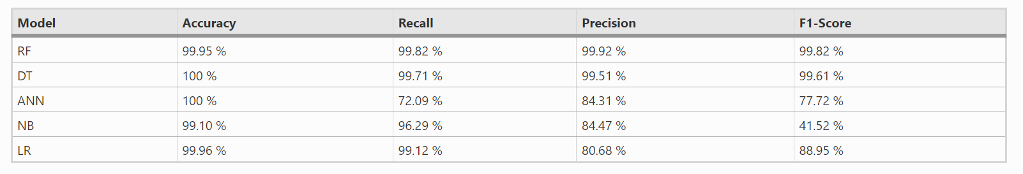
Comparison with other paper results
Ileberi, E., Sun, Y. & Wang, Z. A machine learning based credit card fraud detection using
the GA algorithm for feature selection. J Big Data 9, 24 (2022). https://doi.org/10.1186/s40537-022-00573-8
My best performance is better than their best F1 score and best Recall of the RF model, and slightly less than the precision.
Other models outperform most of their models in Recall, Precision, and F1 score

Slide 19

Thank You!

